Slide 1


Code Syndicate
TEAM MEMBERS
Rohit Kumar Tiwari {2215100018} – Team Leader
Harshit Agrawal {2215000767} -#backend
Harshita Lavania {2215100006} -#frontend
Sarvagya Saxena {2315800073} -#AI/ML
Shreyanshi Jain {2215001711} -#backend
Somesh Rajput {2315800080} -#AI/ML

Slide 2


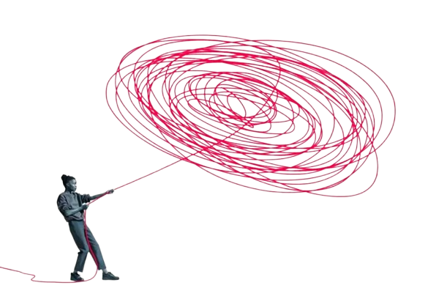


Gamified Constitution Literacy Tool
1703
Smart Education
Tentative Problem Statement
Lack of Constitutional Literacy
Complex Language
Accessibility Barriers
SOFTWARE

Slide 3


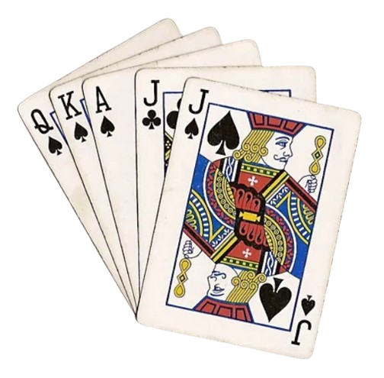

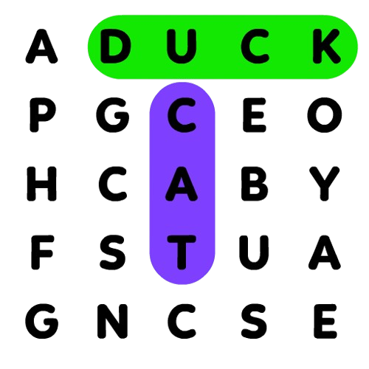
Nagrik Aur Samvidhan ---OR--- Citizen & Constitution
Gamified Platform
Inclusive Design
Multimedia Support
Multilingual
Support
Engage with the Constitution regardless of education
Articles
Increased Participation
Preamble
Age Based Learning
Simplified Content
User Engagement
Duties
Real-Life Application
Principles

